Slide 1

TECHNOLOGICAL INSTITUTE OF THE PHILIPPINES
College of Information Technology Education
Creating Variables, Identifiers, Constants, and Data Types

Slide 2
Intended Learning Outcomes (ILOs)
At the end of the lesson the students should be able to:
Analyze the declaration of variables and data types.
Use different operators appropriately.
Evaluate expressions in solving computer problems.

Slide 3
C++ Basics
The main function ‘main( )’ signals the beginning of the program. Obviously, there cannot be more than one main() function, otherwise the computer woudn’t know where to start.
{ }-The opening brace marks the beginning of the body of the function ‘main()’. The opposite brace is serves as the end of the body.
Semicolon or ; - Statement is a line of code in C and C++ terminated with a semicolon.
cout <<- output or display, it serves as an outputting command. This function is found in the standard library functions of C++ system.
<< endl – position the cursor to the next line instead of using \n.

Slide 4
Features
White Space
You will frequently see references to something called white space.
It is typically used to separate different words in a program.
White space consists of one or more space, tab ( \t) and newline(\n).
The judicious use of white space can make your programs much more readable.

Slide 5
Literal Constants
Literal Constants
Several characters have names that use a back slash notation which is useful when you want to embed one of these characters within a literal character string.
Some examples
Constants Name
\n New Line
\t Tab
\’ Single quotation mark
\” Double quotation mark
\0 Zero

Slide 6
Declarations
It is a characteristic of many computer languages that variables must be declared before they can be used.
A variable declaration gives a name to the variable, and tells the computer what type of data this variable can hold.

Slide 7
Variable Declaration
A declaration of a variable is where a program says that it needs a variable.
For our small programs, place declaration statements between the two braces of the main method.
The declaration gives a name and a data type for the variable.
DataType VariableName;
It may also ask that a particular value be placed in the variable.
DataType VariableName = InitialValue;

Slide 8
Data Types
A data type or simply type is an attribute of data which tells the compiler or interpreter how the programmer intends to use the data.
Number
Integer – Whole Number
Floating Point
Float – numbers with up to 6 decimal places
Double – numbers beyond to 6 decimal places
Character
Character – Single letter or any character enclosed with a single quote
String – combination of alphanumeric values enclosed with a double quote
Boolean
True or False

Slide 9
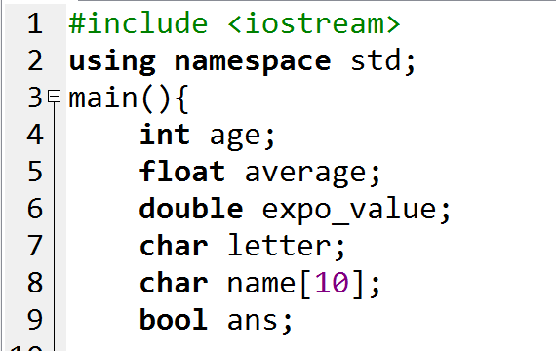
Using The Data Type
DataType VariableName;

Slide 10
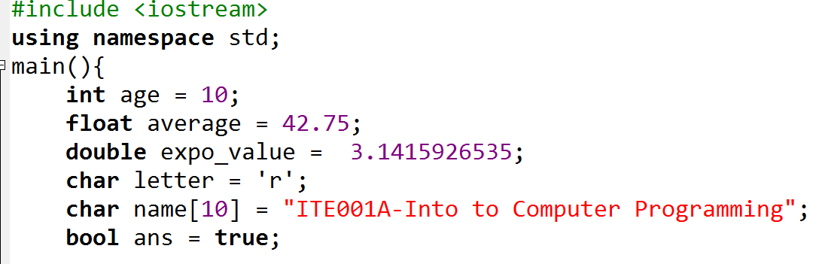
Using The Data Type
DataType VariableName = Value;

Slide 11
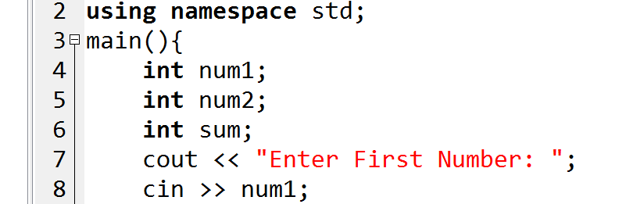
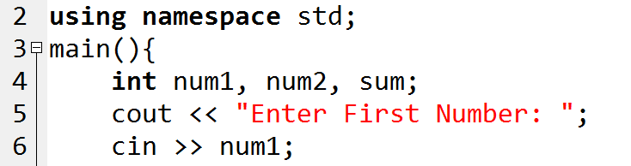
Variable Declaration

Slide 12
Variable
a variable is a storage location (identified by a memory address) paired with an associated symbolic name (an identifier), which contains some known or unknown quantity of information referred to as a value
Examples:
X, XY, name, NUMBER, SAMPLE1, sample2, First_name
FirstName, Sample1, sample1, sAMPLE1

Slide 13
Identifier/ Variable Declaration Rules
A sequence of one or more letters, digits, or underscore characters (_).
Spaces, punctuation marks, and symbols cannot be part of an identifier.
Shall always begin with a letter.
No case can they begin with a digit.
Max 8 chars or depend on compiler and OS
Always exist in the left hand side of assignment operator
No keyword for a variable name

Slide 14
Keywords
Keywords - a word that is reserved by a program because the word has a special meaning.
List of C++ keywords: alignas, alignof, and, and_eq, asm, auto, bitand, bitor, bool, break, case, catch, char, char16_t, char32_t, class, compl, const, constexpr, const_cast, continue, decltype, default, delete, do, double, dynamic_cast, else, enum, explicit, export, extern, false, float, for, friend, goto, if, inline, int, long, mutable, namespace, new, noexcept, not, not_eq, nullptr, operator, or, or_eq, private, protected, public, register, reinterpret_cast, return, short, signed, sizeof, static, static_assert, static_cast, struct, switch, template, this, thread_local, throw, true, try, typedef, typeid, typename, union, unsigned, using, virtual, void, volatile, wchar_t, while, xor, xor_eq

Slide 15
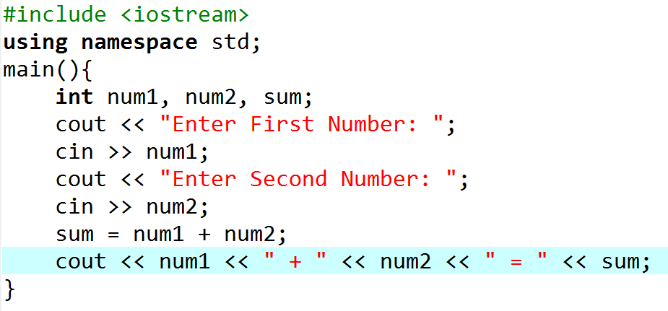
Try this…

Slide 16
Try this…
Change this to float

Slide 17
Features
Comments
// and /*....*/ comments in C++ could be used for representing remarks.
End-of-line Comments //
Everything on the program line to the right of the // characters is ignored and removed by the preprocessors.
One benefit of these comments is the ability to place them within a block style comment.
Since block style comments cannot be nested, these comments offer the ability to nest comments within comments.

Slide 18
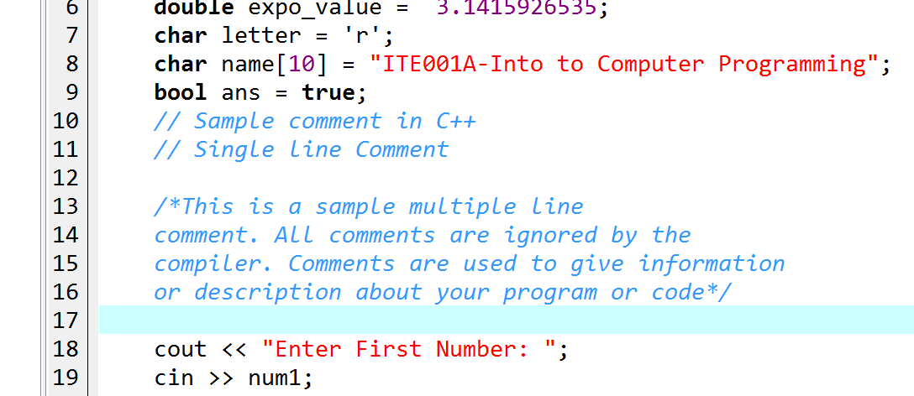
Comments

Slide 19
Common Programming Problems
Same identifiers are used with different letter formats.
C++ is case sensitive. It distinguishes between uppercase and lowercase characters.
Identifiers are predefined keywords in C++.
Programmers should be careful in defining identifiers. They should, as far as possible, be meaningful.

Slide 20
Common Programming Problems
Working with blocks
C++ is a block structured language.
Blocks are defined as: { }.
Blocks are generally used when there are more than one instructions to be executed at a point of condition checking.

